Slide 1


Slide 2
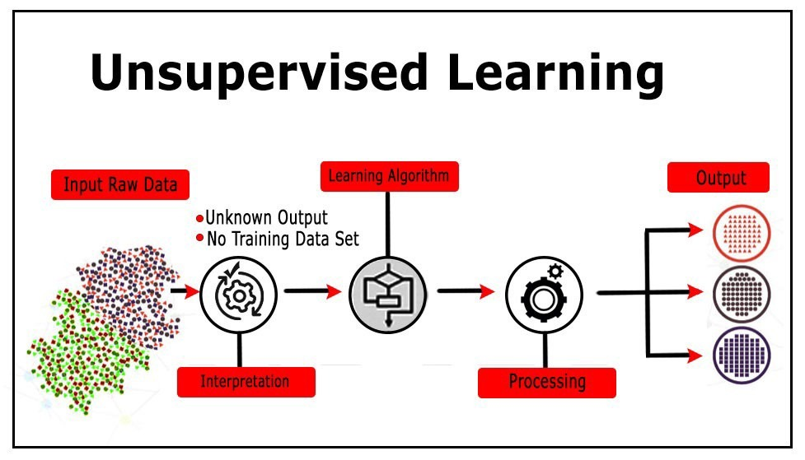
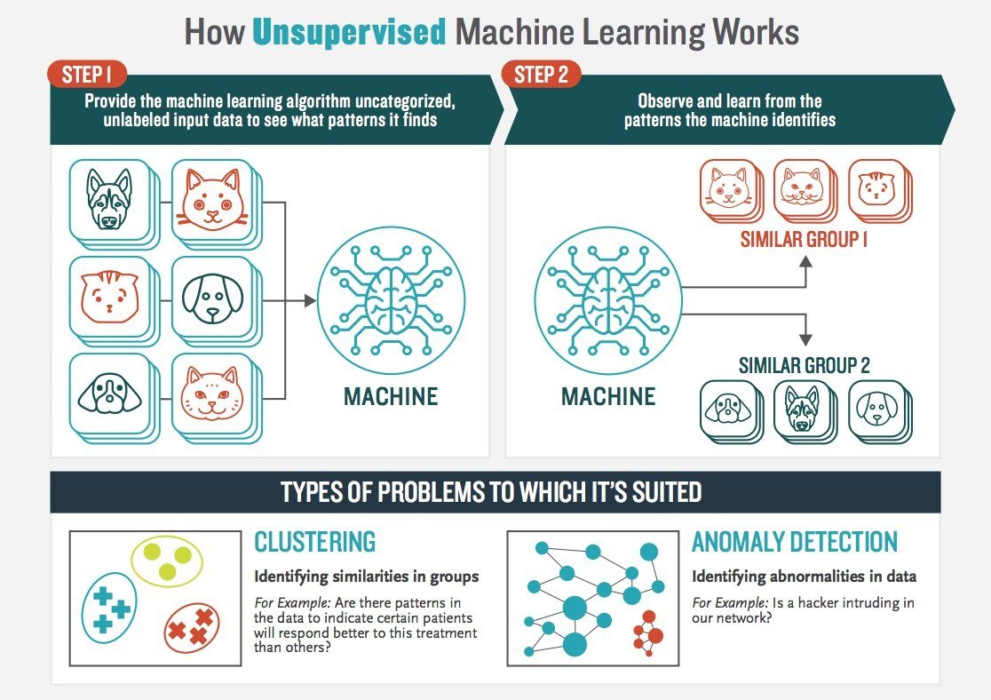
Autoencoders

Slide 3
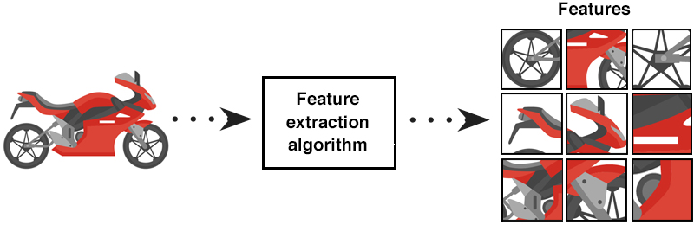
Feature Extraction
Feature Extraction aims to reduce the number of features in a dataset by creating new features from the existing ones (and then discarding the original features).
These new reduced set of features should then be able to summarize most of the information contained in the original set of features.
In this way, a summarized version of the original features can be created from a combination of the original set.
Data
Features

Slide 4
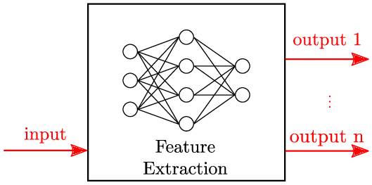
Why Feature Extraction ?
The process of feature extraction is useful when you need to reduce the number of resources needed for processing without losing important or relevant information.
Feature extraction can also reduce the amount of redundant data for a given analysis.
Also, the reduction of the data and the machine’s efforts in building variable combinations (features) facilitate the speed of learning and generalization steps in the machine learning process.

Slide 5
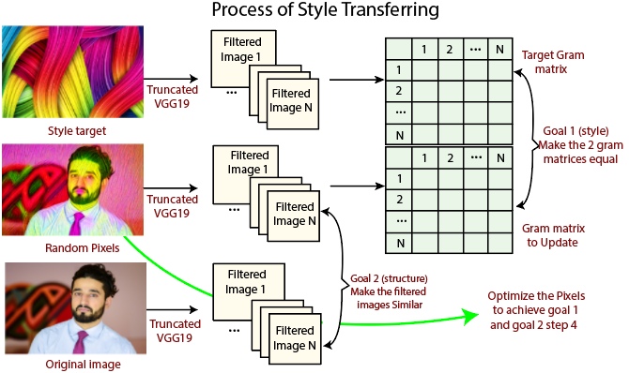
Uses of Feature Extraction in real world
1. Bag of words
2. Image processing
3. Autoencoders

Slide 6
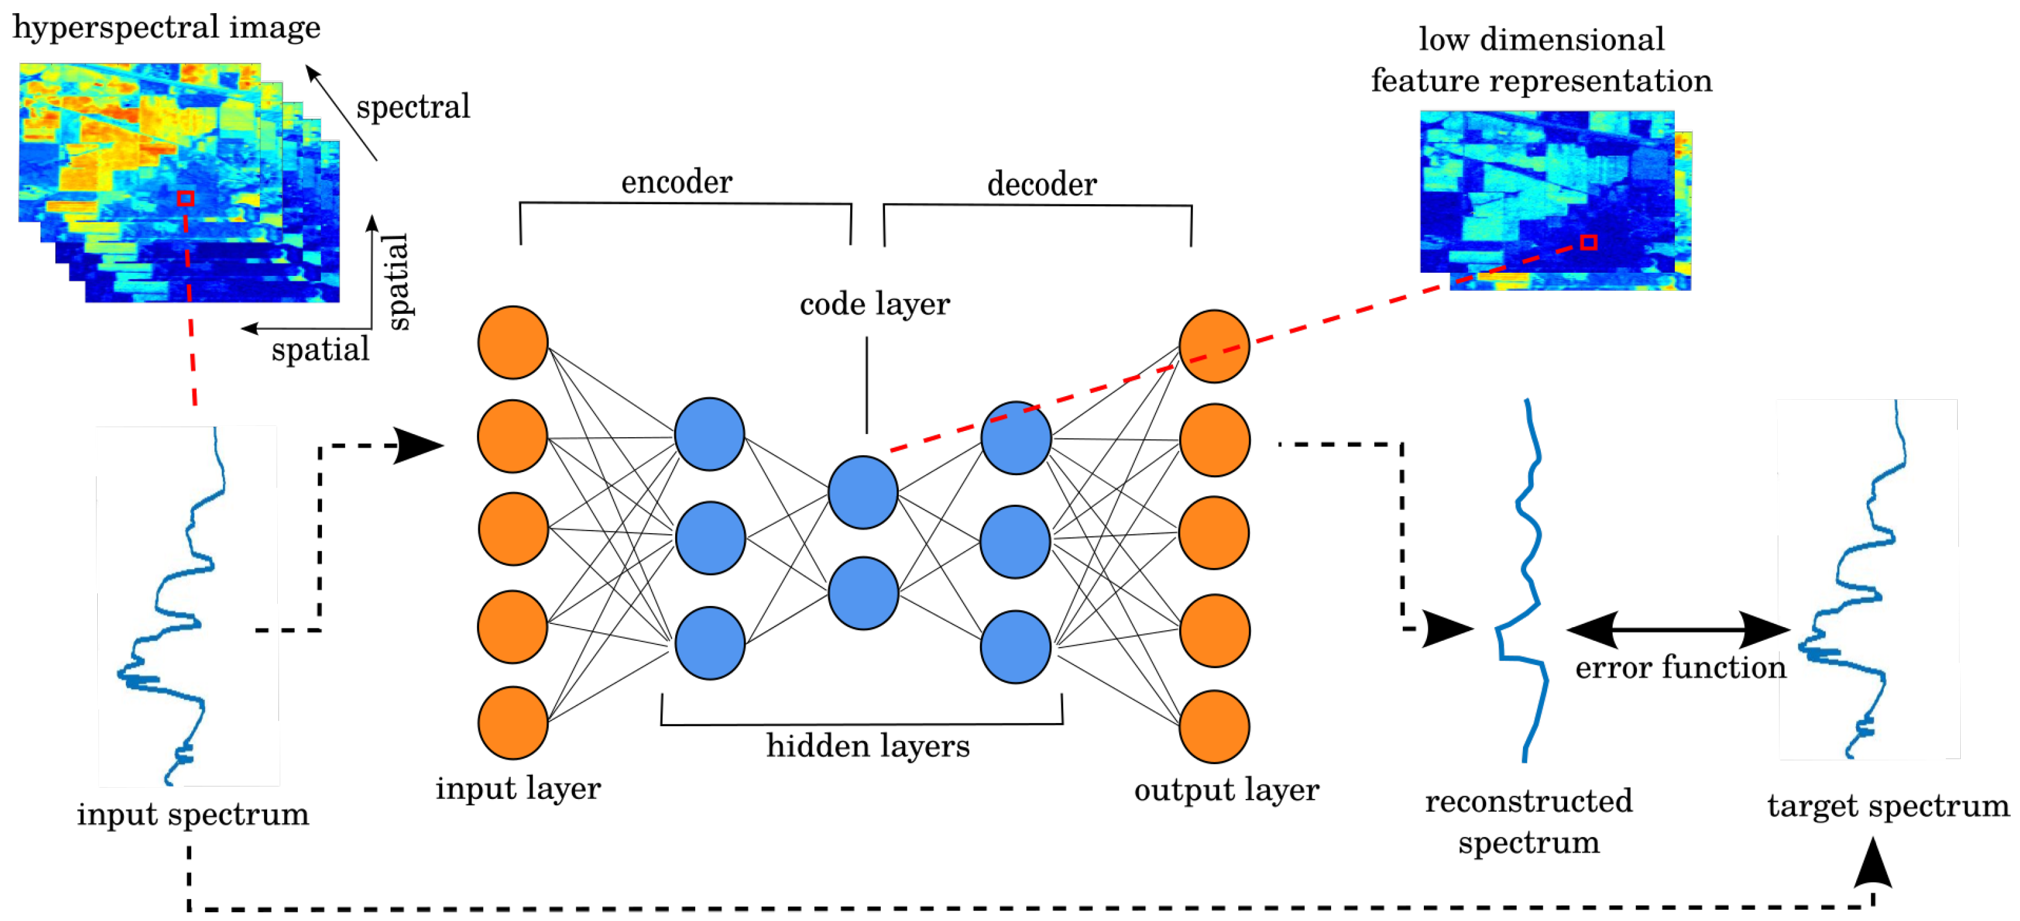
Feature Extraction using Autoencoders
Autoencoders : The main purpose of the auto-encoders is efficient data coding which is unsupervised in nature.
this process comes under unsupervised learning .
So Feature extraction procedure is applicable here to identify the key features from the data to code by learning from the coding of the original data set to derive new ones

Slide 7
Autoencoders
Supervised learning uses explicit labels/correct output in order to train a network.
E.g., classification of images.
Unsupervised learning relies on data only.
E.g., CBOW and skip-gram word embeddings: the output is determined implicitly from word order in the input data.
Key point is to produce a useful embedding of words.
The embedding encodes structure such as word similarity and some relationships.
Still need to define a loss – this is an implicit supervision.

Slide 8
Autoencoders
Autoencoder is an unsupervised artificial neural network that learns how to efficiently compress and encode data.
Autoencoders are neural networks trained to reconstruct their original input.
An Autoencoder is a form of feature extraction algorithm.
Autoencoders can be stacked.
The output of an autoencoder is the middle layer, the representation for each data point.

Slide 9
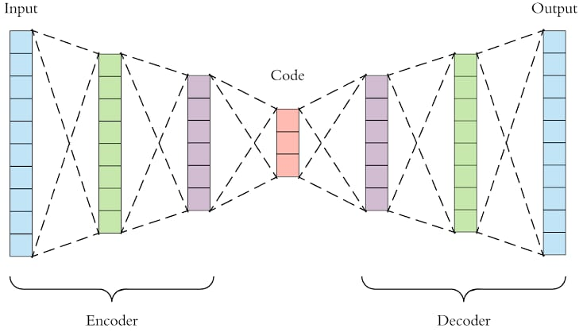
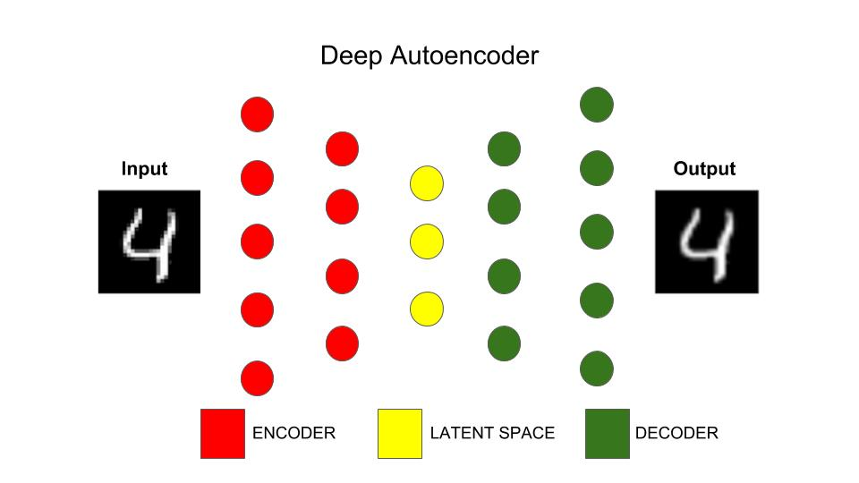
Autoencoders

Slide 10
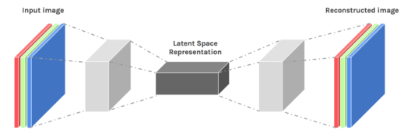
Autoencoders
Autoencoders are designed to reproduce their input, especially for images.
Key point is to reproduce the input from a learned encoding.

Slide 11

Auto-encoder
Usually <784
Compact representation of the input object
NN
Encoder
code
28 X 28 = 784
Learn together
NN
Decoder
Can reconstruct the original object
code

Slide 12
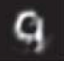
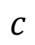
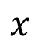
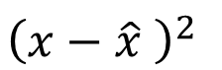

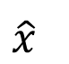
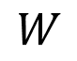
Recap : PCA
Minimize
$${\left(x−\hat{x} \right)}^{2}$$
As close as possible
encode
decode
$$x$$
$$c$$
$$\hat{x}$$
$$W$$
$$W^{T}$$
hidden layer
(linear)
Input layer
output layer
Bottleneck later
Output of the hidden layer is the code

Slide 13
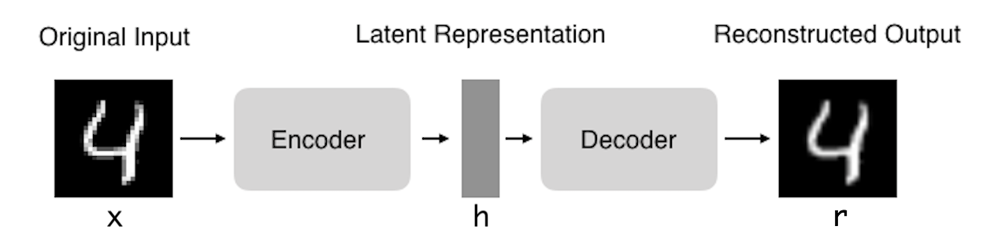
Autoencoders: structure
Encoder: compress input into a latent-space of usually smaller dimension. h = f(x)
Decoder: reconstruct input from the latent space. r = g(f(x)) with r as close to x as possible

Slide 14
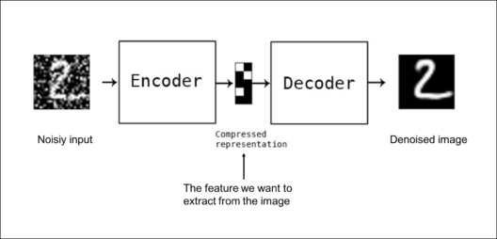
Autoencoders : Application
Denoising: input clean image + noise and train to reproduce the clean image.

Slide 15
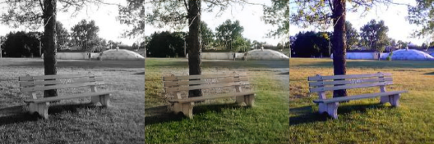
Autoencoders : Application
Image colorization: input black and white and train to produce color images

Slide 16

Autoencoders: Applications
Watermark Removal

Slide 17
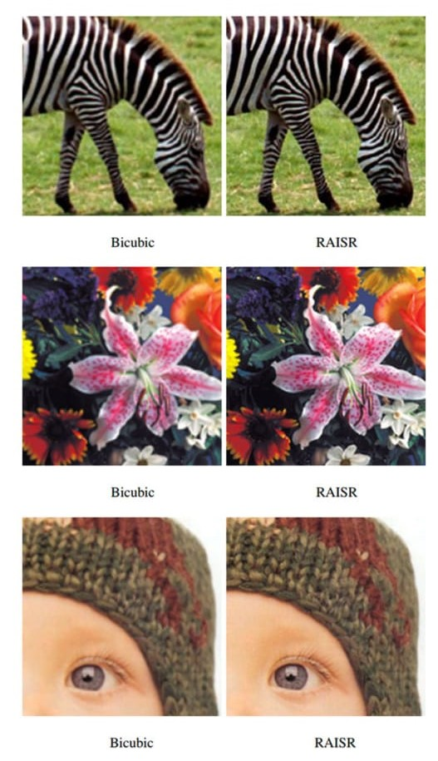
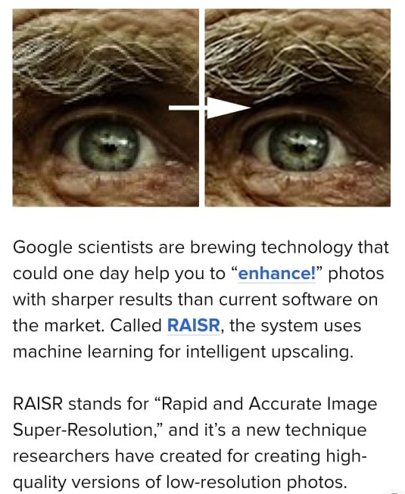
Autoencoders: Applications
With “RAISR: Rapid and Accurate Image Super-Resolution”, Google introduce a technique that incorporates machine learning Autoencoders in order to produce high-quality versions of low-resolution images.
RAISR produces results that are comparable to or better than the currently available super-resolution methods, and does so roughly 10 to 100 times faster, allowing it to be run on a typical mobile device in real-time.

Slide 18
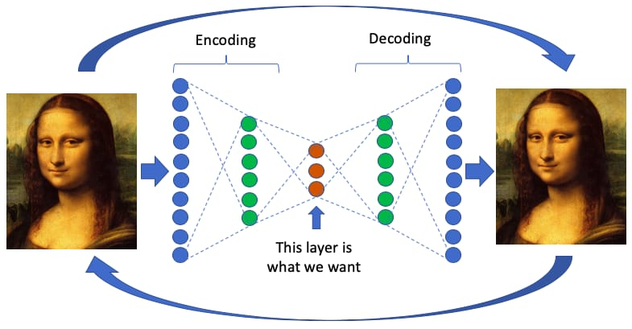
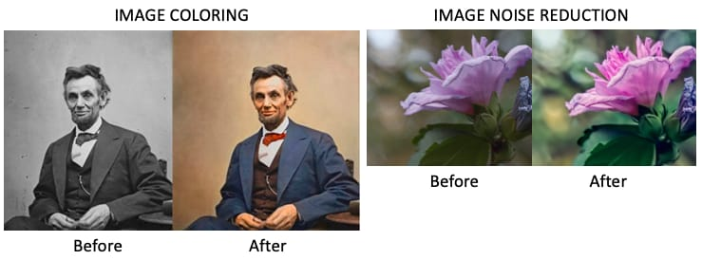
Autoencoders: Applications
Image Denoising - Autoencoders are very good at denoising images. When an image gets corrupted or there is a bit of noise in it, we call this image a noisy image.
To obtain proper information about the content of the image, we perform image denoising.

Slide 19
Properties of Autoencoders:
Data-specific: Autoencoders are only able to compress data similar to what they have been trained on.
Lossy: The decompressed outputs will be degraded compared to the original inputs.
Learned automatically from examples: It is easy to train specialized instances of the algorithm that will perform well on a specific type of input.

Slide 20
Types of Autoencoders:
Vanilla Autoencoder
Multilayer Autoencoder
Convolutional Autoencoder
Regularized Autoencoder
Variational Autoencoder

Slide 21
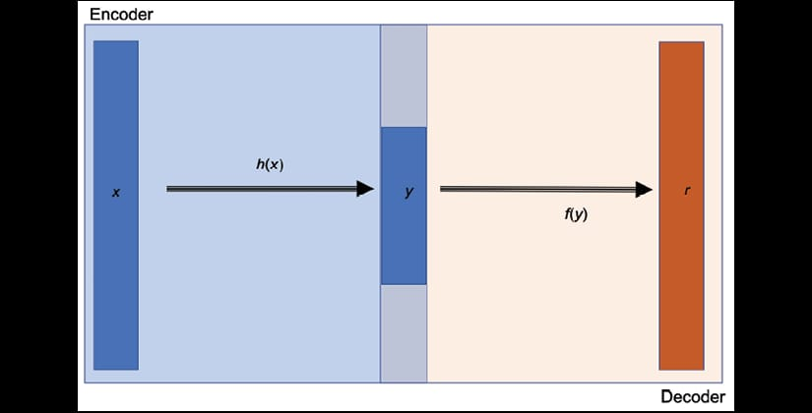
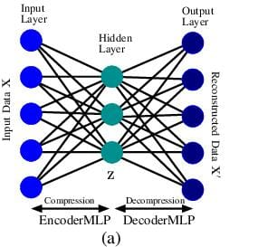
Types of Autoencoders:
Vanilla Autoencoder - In its simplest form.
The autoencoder is a three layers net.
A neural net with one hidden layer.
The input and output are the same, and we learn how to reconstruct the input

Slide 22
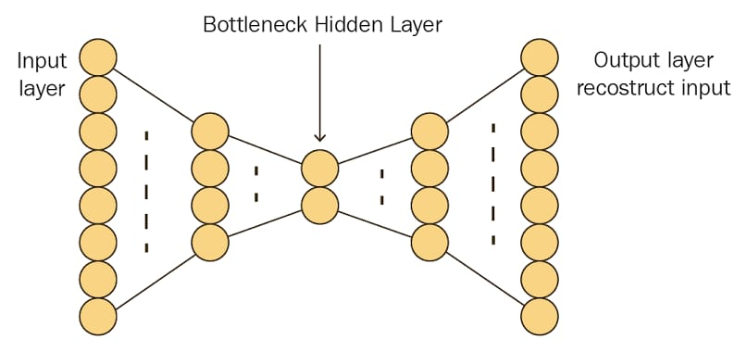
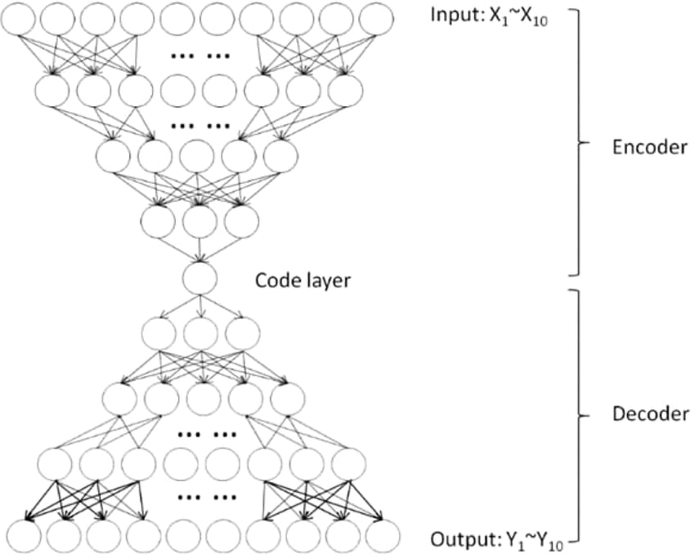
Types of Autoencoders:
Multilayer Autoencoder - If one hidden layer is not enough, we can obviously extend the autoencoder to more hidden layers.
Now our implementation uses 3 hidden layers instead of just one.
Any of the hidden layers can be picked as the feature representation but we will make the network symmetrical and use the middle-most layer.

Slide 23
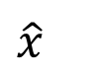
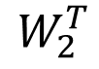
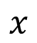
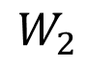
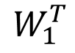
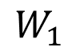
Deep Auto-encoder
Symmetric is not necessary.
Of course, the auto-encoder can be deep
As close as possible
…
…
Layer
Layer
Output Layer
Input Layer
Layer
bottle
Layer
Layer
Layer
$$W_{2}^{T}$$
$$W_{1}$$
$$W_{2}$$
$$W_{1}^{T}$$
Initialize by RBM layer-by-layer
$$x$$
Code
$$\hat{x}$$
Reference: Hinton, Geoffrey E., and Ruslan R. Salakhutdinov. "Reducing the dimensionality of data with neural networks." Science 313.5786 (2006): 504-507

Slide 24
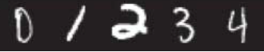
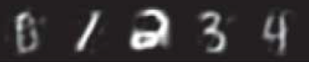
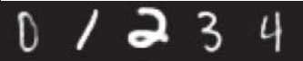
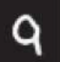
Deep Auto-encoder
Original Image
784
30
784
PCA
Deep
Auto-encoder
784
1000
500
250
30
250
500
784
1000

Slide 25
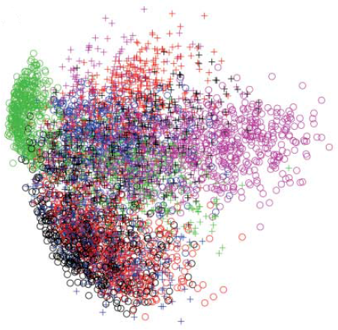
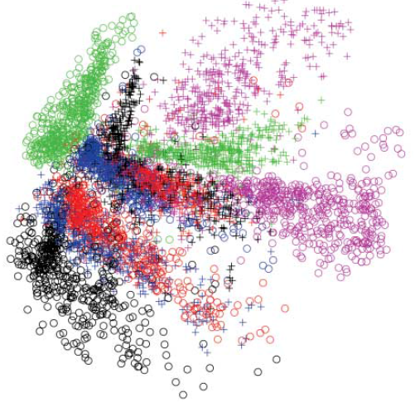
784
2
784
784
1000
500
250
2
250
500
784
1000

Slide 26
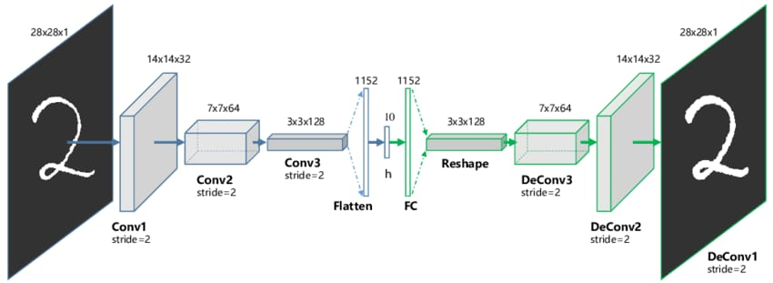
Types of Autoencoders:
Convolutional Autoencoder – Convolutional Autoencoders use the convolution operator to exploit this observation.
They learn to encode the input in a set of simple signals and then try to reconstruct the input from them, modify the geometry or the reflectance of the image.
Due to their convolutional nature, they scale well to realistic-sized high dimensional images.
Can remove noise from picture or reconstruct missing parts.

Slide 27

Auto-encoder for CNN
As close as possible
Deconvolution
Unpooling
Convolution
Deconvolution
Pooling
Unpooling
Convolution
code
Deconvolution
Pooling

Slide 28
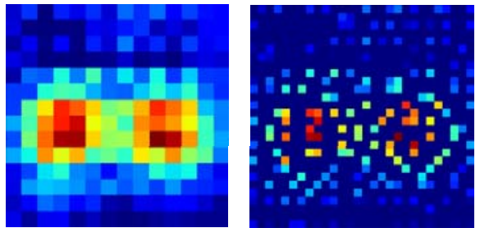
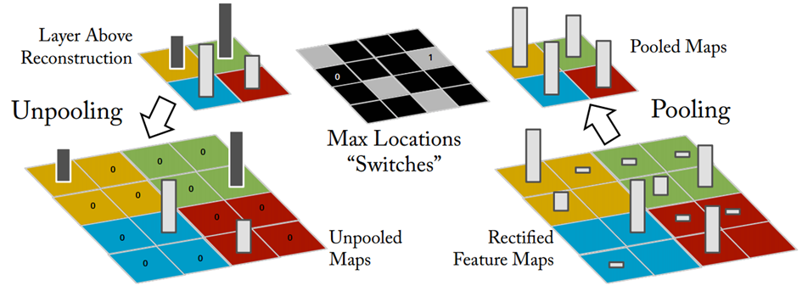
CNN -Unpooling
14 x 14
28 x 28
Alternative: simply repeat the values
Source of image : https://leonardoaraujosantos.gitbooks.io/artificial-inteligence/content/image_segmentation.html

Slide 29
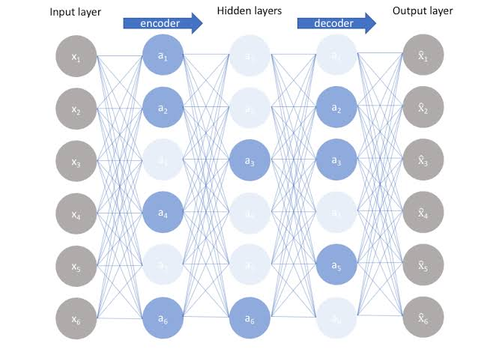
Types of Autoencoders:
Regularized Autoencoder - Regularized autoencoders use a loss function that encourages the model to have other properties besides the ability to copy its input to its output.
In practice, we usually find two types of regularized autoencoder: the sparse autoencoder and the denoising autoencoder.

Slide 30
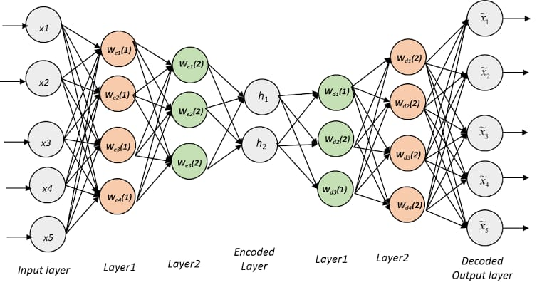
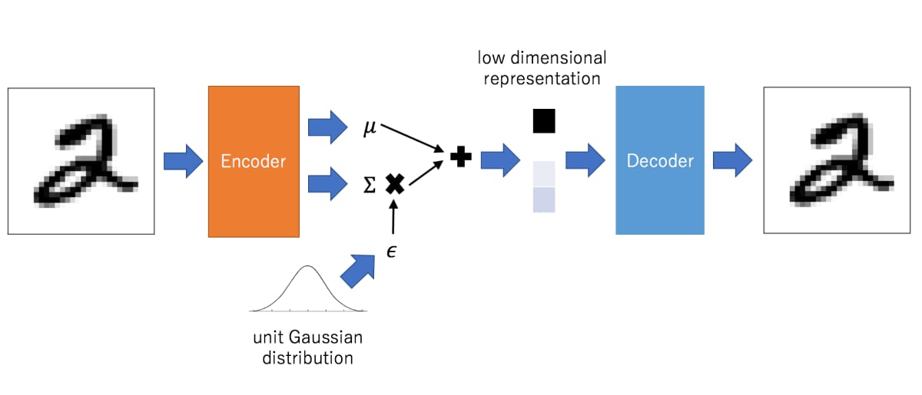
Types of Autoencoders:
Variational Autoencoder - Variational autoencoder models make strong assumptions concerning the distribution of latent variables.
It assumes that the data is generated by a directed graphical model and that the encoder is learning an approximation to the posterior distribution where Ф and θ denote the parameters of the encoder (recognition model) and decoder (generative model) respectively.
The probability distribution of the latent vector of a variational autoencoder typically matches that of the training data much closer than a standard

Slide 31
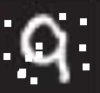
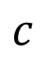
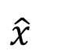
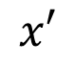
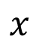
More: Contractive auto-encoder
Auto-encoder
Ref: Rifai, Salah, et al. "Contractive auto-encoders: Explicit invariance during feature extraction.“ Proceedings of the 28th International Conference on Machine Learning (ICML-11). 2011.
De-noising auto-encoder
As close as possible
encode
decode
$$c$$
$$x$$
$$x′$$
$$\hat{x}$$
Add noise
Vincent, Pascal, et al. "Extracting and composing robust features with denoising autoencoders." ICML, 2008.

Slide 32
Auto-encoder – Text Retrieval
Vector Space Model
Bag-of-word
this
1
is
1
word string:
“This is an apple”
query
a
0
an
1
…
apple
1
pen
0
document
Semantics are not considered.

Slide 33
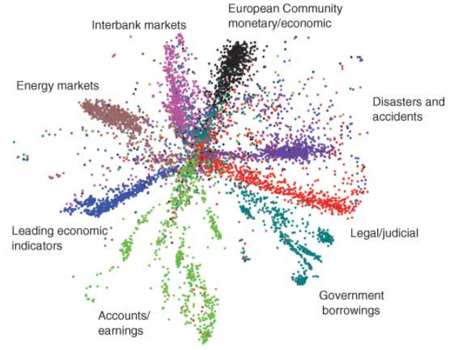

Auto-encoder – Text Retrieval
The documents talking about the same thing will have close code.
2
query
125
250
500
2000
LSA: project documents to 2 latent topics
Bag-of-word
(document or query)

Slide 34
References:
https://hackernoon.com/autoencoders-deep-learning-bits-1-11731e200694
https://blog.keras.io/building-autoencoders-in-keras.html
https://www.technologyreview.com/s/513696/deep-learning/
https://www.analyticsvidhya.com/blog/2019/08/3-techniques-extract-features-from-image-data-machine-learning-python/
https://www.kaggle.com/guilhermeviveiros/autoencoders-and-variational-auto-encoders-vae
https://github.com/udacity/deep-learning-v2-pytorch/tree/master/autoencoder
https://arxiv.org/pdf/1606.01299
https://www.semanticscholar.org/paper/Dimensionality-Reduction-Using-Neural-Networks-Teli/39aaa1d7a5c670177cf2a41a9fb49361a17241ef

Slide 35


